Slide 1
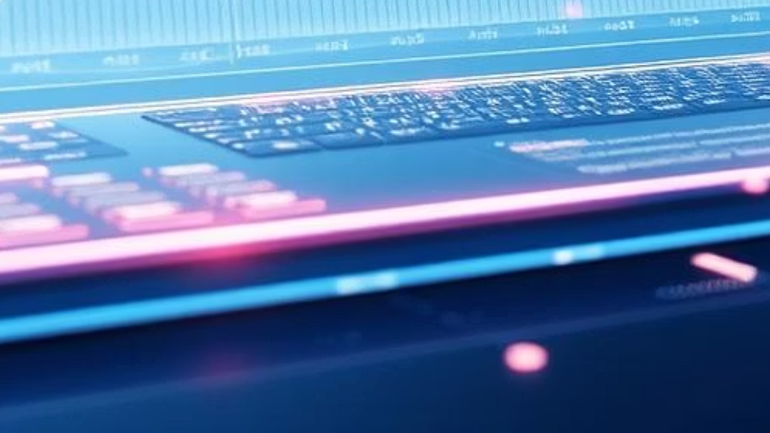
Sentiview – Real-Time Sentiment Analysis
Web App
Presented by:
Emmanuel Osei (C0932615)
Gabriel Assiakwa (C0903299)
Millicent Cudjoe (C0934561)
Gopika Santhosh (C0934411)
Martha Kanyi (C0906214)

Slide 2
The Challenge: Understanding the Unspoken Word
Massive Text Data
Need for Real-time Insights
Bridging the Gap
The internet is overflowing with user-generated text – from social media to reviews. Businesses struggle to process this volume manually.
Our goal: to instantly detect sentiment from any given text, providing immediate, actionable insights.
Decisions need to be made fast. Manual analysis is too slow to keep up with the dynamic nature of online conversations.

Slide 3


Project Objectives: What Sentiview Delivers
Real-time Analysis
Sentiment Prediction
Instantaneously processes text input for sentiment.
Accurately classifies text as Positive, Negative, or Neutral.
Confidence Score
Visualizations
Provides a numerical confidence level for each prediction, indicating reliability.
Generates insightful charts and word clouds for better understanding.

Slide 4

Under the Hood: Our Tech Stack
Programming Language:
Python: Chosen for its extensive libraries and active community in data science.
Key Libraries & Tools:
NLP: spaCy (for efficient language processing) & NLTK (for foundational NLP tasks).
Machine Learning: scikit-learn (Logistic Regression, Support Vector Machines for robust classification).
Feature Engineering: TF-IDF (Text Frequency-Inverse Document Frequency for converting text to numerical vectors).
Visualization: Matplotlib & WordCloud (for clear, intuitive data representation).
Development Environment: Google Colab (for collaborative coding and experimentation).

Slide 5
Sentiview in Action: System Workflow
Text Input
Input
Receive raw text data from customer review (Amazon Review: Unlocked Mobile Phones)
https://www.kaggle.com/datasets/PromptCloudHQ/amazon-reviews-unlocked-mobile-phones
Preprocessing
Preprocessing
Cleanse text, convert to lowercase, remove stopwords, and apply tokenization and lemmatization for normalized analysis.
Feature Extraction
Transform processed text into numerical features using advanced techniques like TF-IDF (Term Frequency-Inverse Document Frequency).
Feature Extraction
Prediction
Utilize a fine-tuned BERT model to predict sentiment (positive, negative, neutral) and assign a confidence score, indicating prediction reliability.
Prediction & Viz
Output
Deliver categorized sentiment labels and rich visualizations for immediate consumption and deeper data exploration.

Slide 6
Preprocessing Pipeline: Cleaning the Data
Raw text is noisy. Our robust preprocessing pipeline transforms unstructured data into a usable format for the models.
01
02
Text Normalization
Tokenization & Stopword Removal
All text is converted to lowercase, and punctuation is meticulously removed to reduce noise.
Text is broken into individual words (tokens), and common, non-informative words (stopwords like 'the', 'is') are filtered out.
03
04
Lemmatization
TF-IDF Vectorization
Using spaCy, words are reduced to their base form (e.g., 'running' becomes 'run'), improving consistency.
Cleaned text is converted into numerical vectors, representing word importance, ready for machine learning models.
Example: 'I loved the phone, but the battery life was terrible!' → Preprocessed: 'love phone battery life terrible'

Slide 7
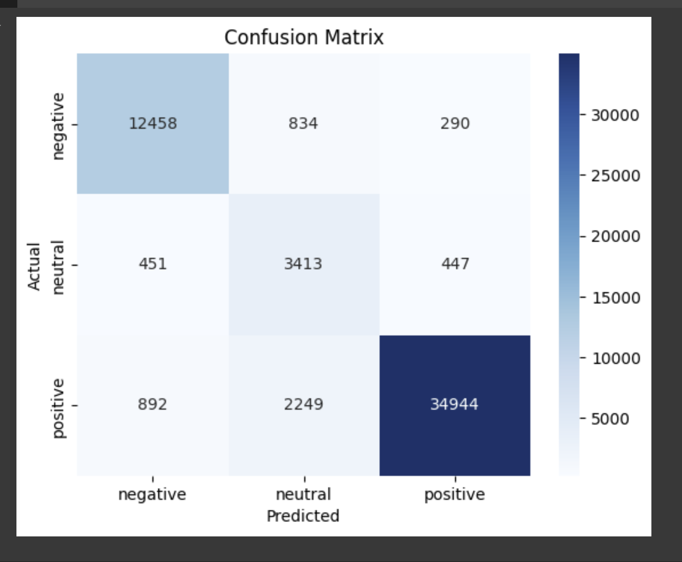
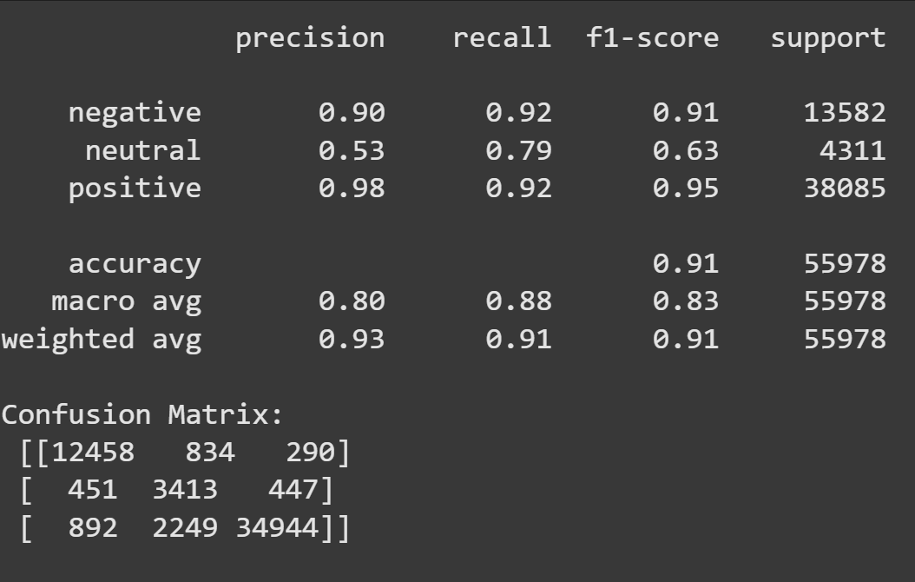

Model Training & Evaluation: Ensuring Accuracy
We trained and rigorously evaluated two powerful classification models:
Logistic Regression: A simple yet effective linear model for binary and multi-class
classification.
Support Vector Machines (SVM): A robust model known for its performance in text classification tasks, particularly with high-dimensional data.
Dataset Split:
80% for training the models to learn patterns.
20% held back for testing to ensure unbiased evaluation of performance.
Key Evaluation Metrics:
Accuracy: Overall correctness of predictions.
Precision, Recall, F1 Score: Detailed metrics to assess the balance between false
positives and false negatives for each sentiment class.
Our models achieved high accuracy, demonstrating their effectiveness in real-world sentiment detection.

Slide 8
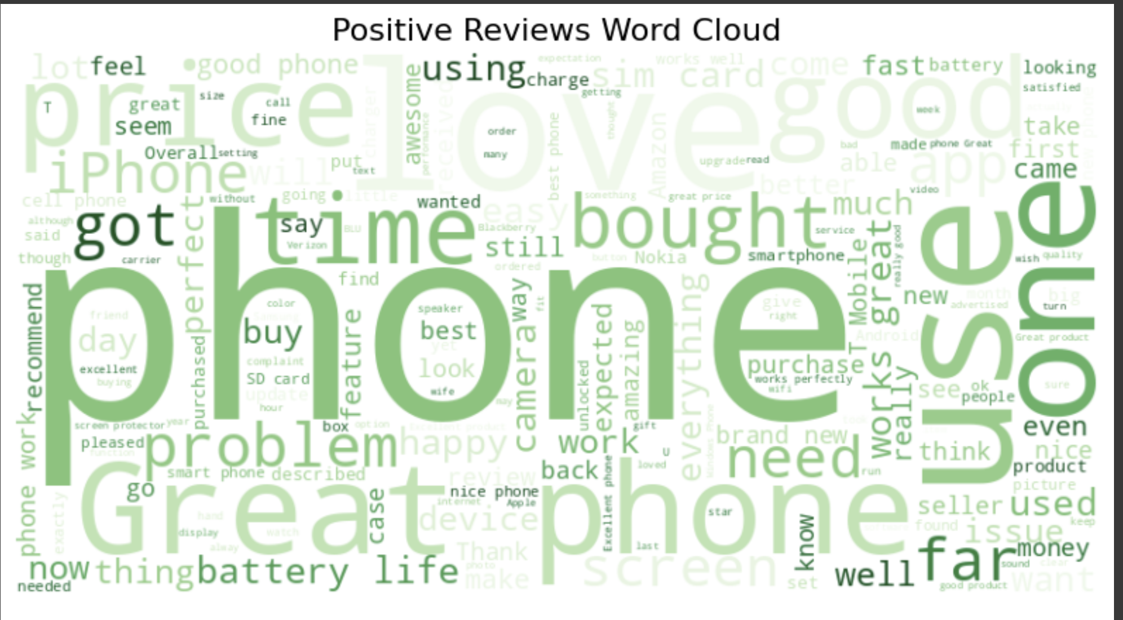
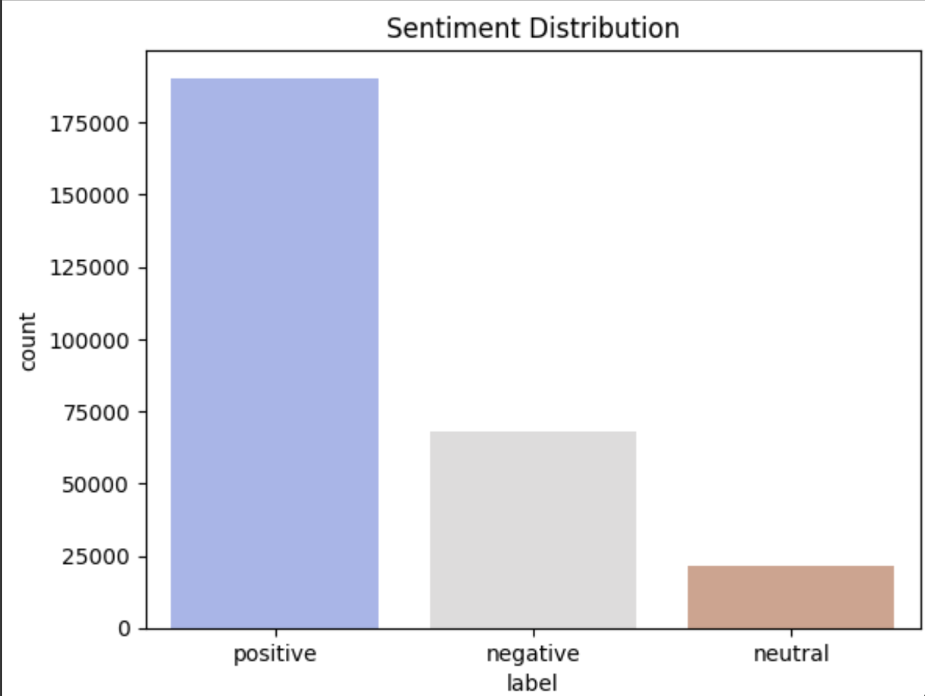
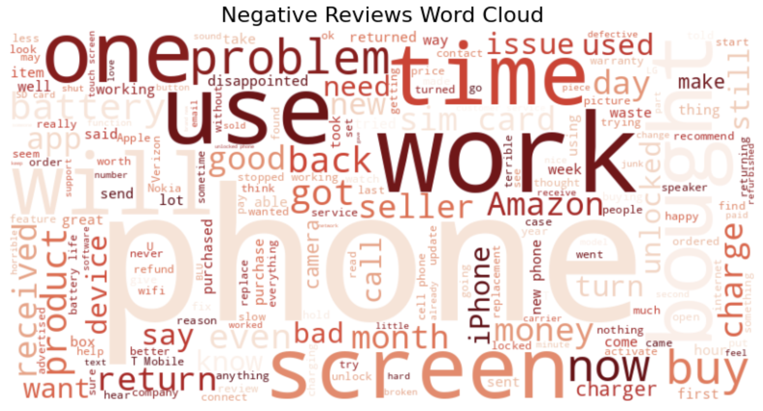
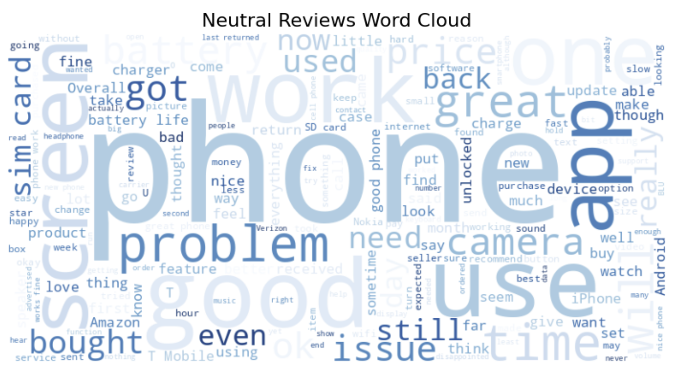
Unveiling Insights with Intuitive Visualizations
Dynamic Word Clouds
Overall Sentiment Distribution
Instantly visualize the most frequent words associated with positive, negative, or neutral sentiments. Our interactive word clouds highlight key themes and emerging trends at a glance.
A clear bar chart breaks down the total sentiment into positive, negative, and neutral categories, providing an immediate overview of overall public opinion.

Slide 9
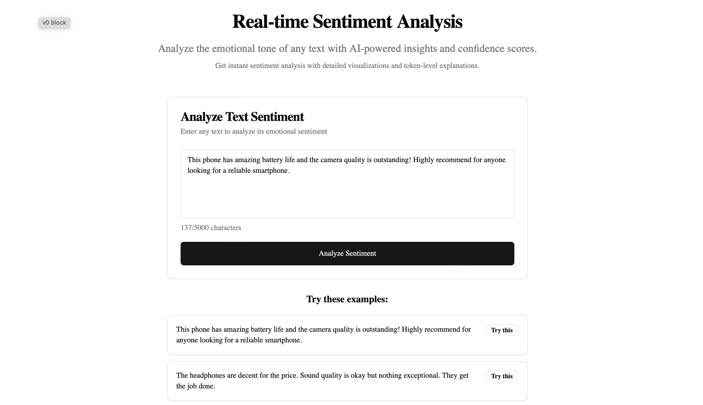
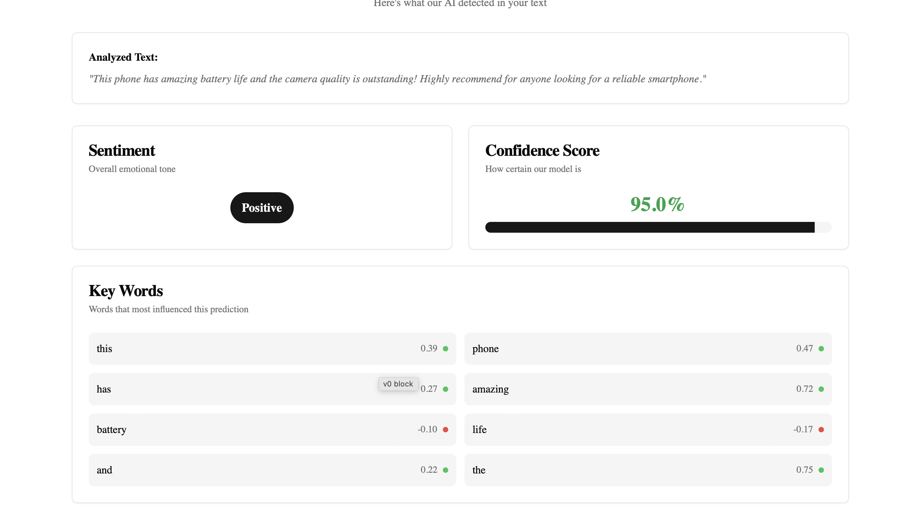
THE APP

Slide 10
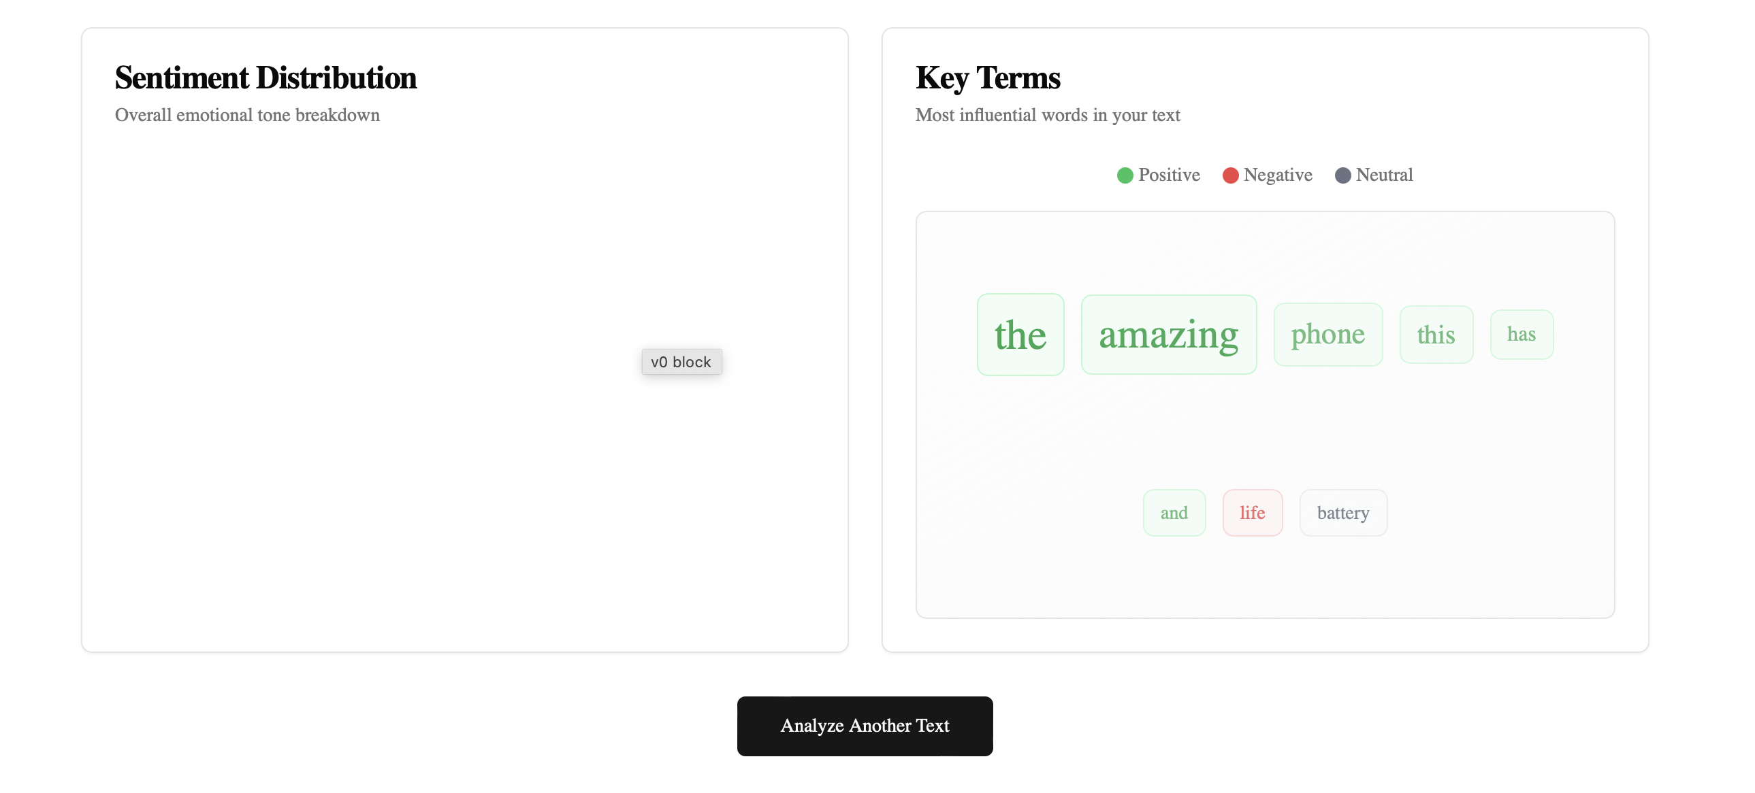
✔️ Fast ✔️ Accurate ✔️ Interpretable

Slide 11
Limitations & Future Work: The Road Ahead
Current Limitations:
Future Enhancements:
Context Understanding: Limited ability to grasp deep contextual nuances and cultural references.
Live Twitter Integration: Implement direct API integration for real-time sentiment analysis of tweets.
Sarcasm Detection: Difficulty in identifying sarcasm or irony, which can flip sentiment.
Advanced Models: Explore and integrate state-of-the-art transformer models (e.g., BERT, GPT) for superior contextual understanding.
Dataset Quality Dependence: Performance is heavily reliant on the diversity and quality of the training data.
Enhanced UI: Develop a user-friendly web interface using frameworks like Streamlit or Flask for broader accessibility and interactive demonstrations.
Sentiview is a powerful foundation, and our ongoing research aims to push the boundaries of real-time sentiment analysis.

Slide 12
Conclusion: Real-World Readiness
Real-Time Sentiment Analysis
High Model Performance
Sentiview delivers instant insights, processing data as it arrives.
Our fine-tuned models ensure accurate sentiment detection.
Ready for Real-World Use
Scalable NLP Integration
A robust, scalable solution built for practical applications.
Designed for future expansion with more advanced NLP models.

Slide 13
Thank You!
For more information, please visit our GitHub repository.
https://github.com/genghiskhan99/sentiview-sentiment-analysis
Link to App
https://v0-image-analysis-jade-five-90.vercel.app/

